Slide 1
CSC 323 – Principles of Operating Systems
Instructor: Ms. Mamoona Tasadduq
Lecture# 11: Mass Storage Management

Slide 2
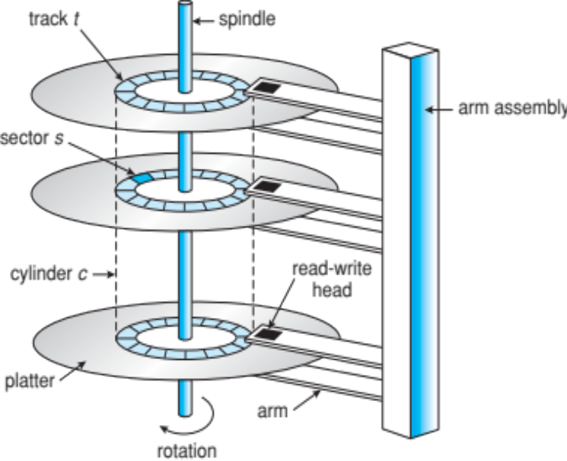
Overview
Bulk of secondary storage for modern computers is hard disk drives (HDDs) and nonvolatile memory (NVM) devices
HDDs spin platters of magnetically-coated material under moving read-write heads
  Drives rotate at 60 to 250 times per second
  Transfer rate is rate at which data flow between drive and computer
  Positioning time (random-access time) is time to move disk arm to desired cylinder (seek time) and time for desired sector to rotate under the disk head (rotational latency)
Disks can be removable

Slide 3
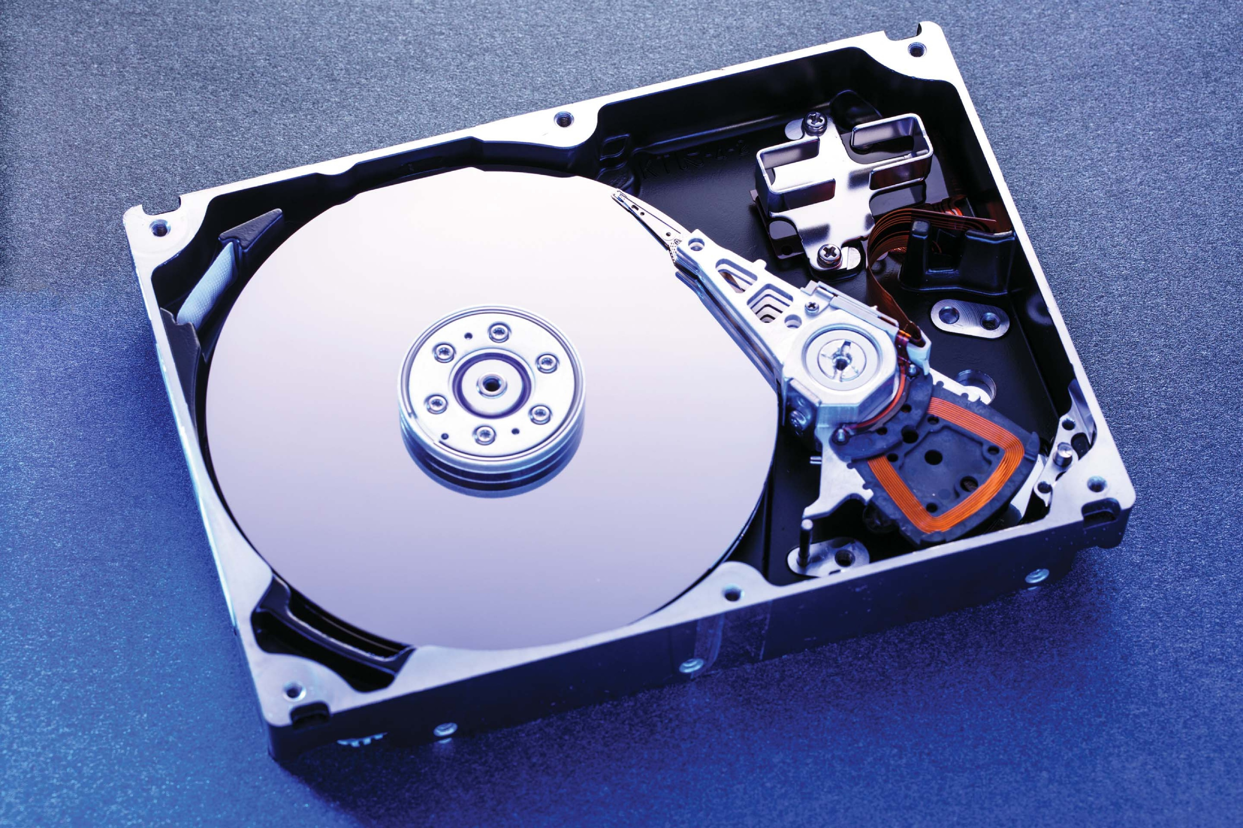
Hard Disk Drives
Platters range from 0.85” to 14” (historically)
  Commonly 3.5”, 2.5”, and 1.8”
Range from 30GB to 3TB per drive
Performance
  Transfer Rate – theoretical – 6 Gb/sec
  Effective Transfer Rate – real – 1Gb/sec
  Seek time from 3ms to 12ms – 9ms common for desktop drives
  Average seek time measured or calculated based on 1/3 of tracks
  Latency based on spindle speed
    1 / (RPM / 60) = 60 / RPM
  Average latency = ½ latency

Slide 4
Hard Disk Performance
Access Latency = Average access time = average seek time + average latency
  For fastest disk 3ms + 2ms = 5ms
  For slow disk 9ms + 5.56ms = 14.56ms
Average I/O time = average access time + (amount to transfer / transfer rate) + controller overhead
For example, to transfer a 4KB block on a 7200 RPM disk with a 5ms average seek time, 1Gb/sec transfer rate with a 0.1ms controller
overhead =
  5ms + 4.17ms + 0.1ms + transfer time =
  Transfer time = 4096 bytes × 8 bits/byte / 1024^3 bits/second = 0.031ms= 0.031 ms
  Average I/O time for 4KB block = 9.27ms + .031ms = 9.301ms

Slide 5
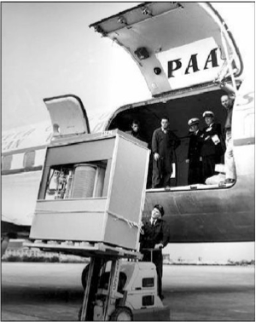
The First Commercial Disk Drive
1956
IBM RAMDAC computer included the IBM Model 350 disk storage system
5M (7 bit) characters
50 x 24” platters
Access time = < 1 second

Slide 6
Nonvolatile Memory Devices
Solid-state disks (SSDs) used like traditional hard drives.
Other forms include USB drives (thumb drive, flash drive), DRAM disk replacements, surface-mounted on motherboards, and main storage in devices like smartphones
Can be more reliable than HDDs
More expensive per MB
Maybe have shorter life span – need careful management
Less capacity
But much faster
Buses can be too slow ➔ to connect directly to PCI, for example
No moving parts, so no seek time or rotational latency
They use fast CMOS-based memory, enabling instant data access and providing much higher throughput than HDDs.

Slide 7
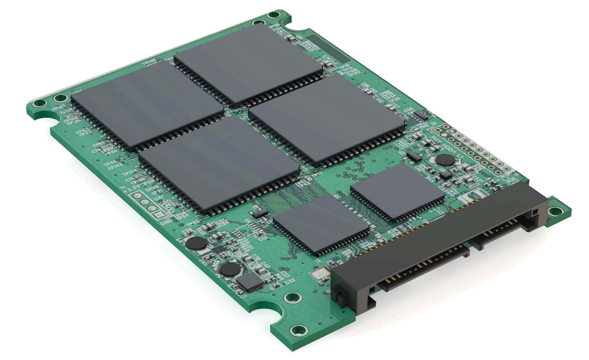
Nonvolatile Memory Devices
Have characteristics that present challenges
Read and write in “page” increments but can’t overwrite in place
  Must first be erased, and erases happen in larger ”block” increments
  Can only be erased a limited number of times before worn out – ~ 100,000
  Life span measured in drive writes per day (DWPD)
    A 1TB NAND drive with a rating of 5DWPD is expected to have 5TB per day written within the warranty period without failing

Slide 8

NAND Flash Controller Algorithms
With no overwrite, pages end up with mix of valid and invalid data
To track which logical blocks are valid, controller maintains flash translation layer (FTL) table
Also implements garbage collection to free invalid page space
Allocates overprovisioning to provide working space for GC
Each cell has lifespan, so wear leveling needed to write equally to all cells
NAND block with valid and invalid pages

Slide 9
Volatile Memory
DRAM frequently used as mass-storage device
  Not technically secondary storage because volatile, but can have file systems, be used like very fast secondary storage
RAM drives (with many names, including RAM disks) present as raw block devices, commonly file system formatted
Computers have buffering, caching via RAM, so why RAM drives?
  Caches / buffers allocated / managed by programmer, operating system, hardware
  RAM drives under user control
  Found in all major operating systems
    Linux /dev/ram, macOS diskutil to create them, Linux /tmp of file system type tmpfs
Used as high-speed temporary storage
  Programs could share bulk date, quickly, by reading/writing to RAM drive

Slide 10
Magnetic Tape
Was early secondary-storage medium
  Evolved from open spools to cartridges
Relatively permanent and holds large quantities of data
Access time slow
Random access ~1000 times slower than disk
Mainly used for backup, storage of infrequently-used data, transfer medium between systems
Kept in spool and wound or rewound past read-write head
Once data under head, transfer rates comparable to disk
  140MB/sec and greater
200GB to 1.5TB typical storage
Common technologies are LTO-{3,4,5} and T10000

Slide 11
Disk Attachment
Host-attached storage accessed through I/O ports talking to I/O busses
Several busses available, including advanced technology attachment (ATA), serial ATA (SATA), eSATA, serial attached SCSI (SAS), universal serial bus (USB), and fibre channel (FC).
Most common is SATA
Because flash based NVM much faster than HDD, new fast interface for NVM called NVM express (NVMe), connecting directly to PCI bus
Data transfers on a bus carried out by special electronic processors called controllers (or host-bus adapters, HBAs)
Host controller on the computer end of the bus, device controller on device end
Computer places command on host controller, using memory-mapped I/O ports
  Host controller sends messages to device controller
  Data transferred via DMA between device and computer DRAM

Slide 12
Address Mapping
Disk drives are addressed as large 1-dimensional arrays of logical blocks, where the logical block is the smallest unit of transfer
  Low-level formatting creates logical blocks on physical media
The 1-dimensional array of logical blocks is mapped into the sectors of the disk sequentially
  Sector 0 is the first sector of the first track on the outermost cylinder
  Mapping proceeds in order through that track, then the rest of the tracks in that cylinder, and then through the rest of the cylinders from outermost to innermost
  Logical to physical address should be easy
    Except for bad sectors
    Non-constant # of sectors per track via constant angular velocity

Slide 13
Disk Scheduling
The operating system is responsible for using hardware efficiently — for the disk drives, this means having a fast access time and disk bandwidth
Minimize seek time
Seek time ≈ seek distance
Disk bandwidth is the total number of bytes transferred, divided by the total time between the first request for service and the completion of the last transfer
There are many sources of disk I/O request
  OS
  System processes
  Users' processes
I/O request includes input or output mode, disk address, memory address, number of sectors to transfer
OS maintains queue of requests, per disk or device
Idle disk can immediately work on I/O request, busy disk means work must queue
  Optimization algorithms only make sense when a queue exists

Slide 14
Disk Scheduling
Note that drive controllers have small buffers and can manage a queue of I/O requests (of varying “depth”)
Several algorithms exist to schedule the servicing of disk I/O requests
The analysis is true for one or many platters
We illustrate scheduling algorithms with a request queue (0-199)
Queue = 98, 183, 37, 122, 14, 124, 65, 67
(Head pointer starts at 53)

Slide 15
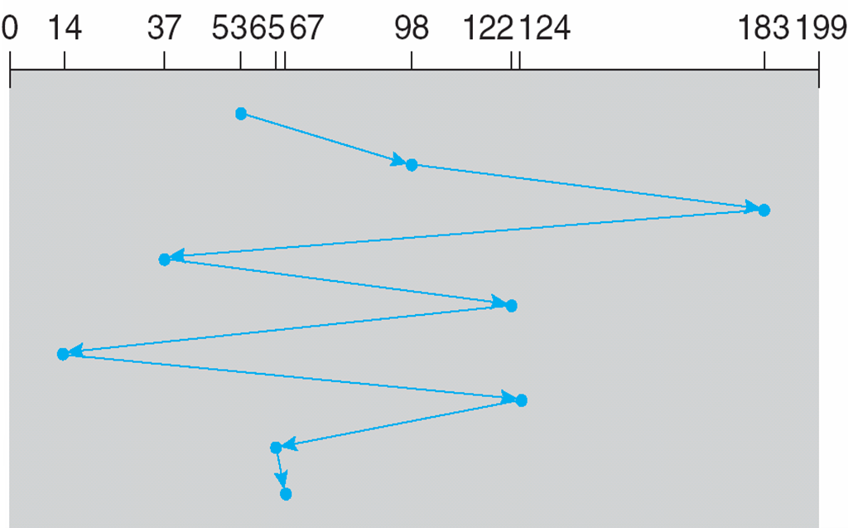
Disk Scheduling (FCFS)
Queue = 98, 183, 37, 122, 14, 124, 65, 67
(Head pointer starts at 53)
Illustration shows total head movement of 640 cylinders

Slide 16
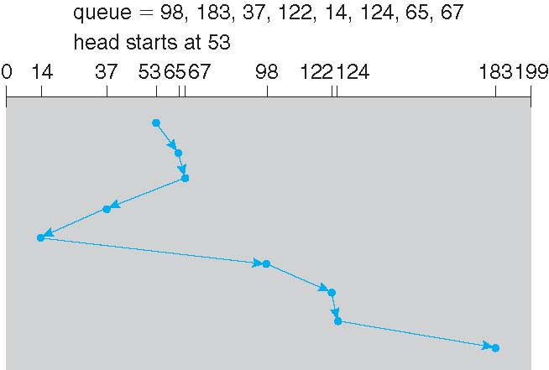
Disk Scheduling (SSTF)
Queue = 98, 183, 37, 122, 14, 124, 65, 67
(Head pointer starts at 53)
Illustration shows total head movement of 236 cylinders

Slide 17
Disk Scheduling (SCAN)
The disk arm starting at one end of the disk, and moving toward the other end, servicing requests until it gets to the other end of the disk, where the head movement is reversed, and servicing continues.
SCAN algorithm sometimes also called elevator algorithm
Request at the other end of the disk wait the longest.

Slide 18
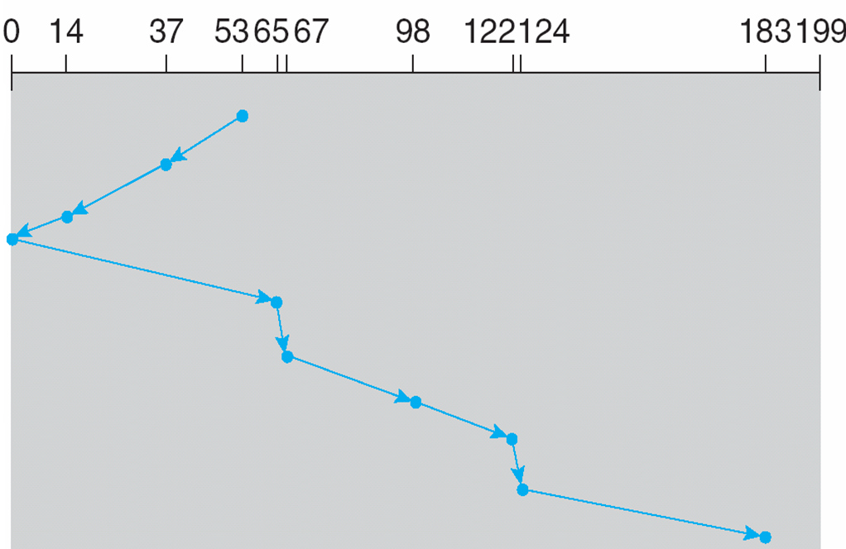
Disk Scheduling (SCAN)
Queue = 98, 183, 37, 122, 14, 124, 65, 67
(Head pointer starts at 53)
Illustration shows total head movement of 236 cylinders

Slide 19
Disk Scheduling (C-SCAN)
Provides a more uniform wait time than SCAN
Head moves from one end of the disk to the other, servicing requests as it goes
  When it reaches the other end, however, it immediately returns to the beginning of the disk, without servicing any requests on the return trip
Treats the cylinders as a circular list that wraps around from the last cylinder to the first one

Slide 20
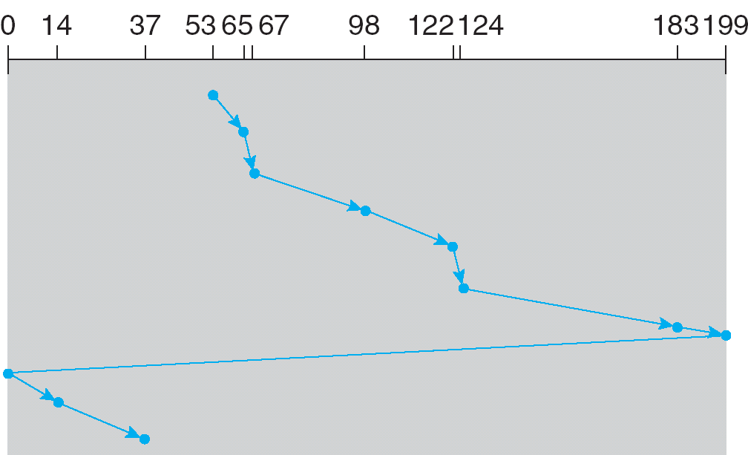
Disk Scheduling (C-SCAN)
Queue = 98, 183, 37, 122, 14, 124, 65, 67
(Head pointer starts at 53)
Illustration shows total head movement of 382 cylinders

Slide 21
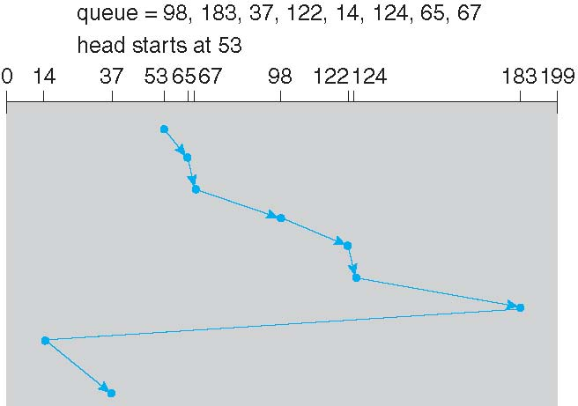
Disk Scheduling (LOOK and C-LOOK)
LOOK, a version of SCAN, C-LOOK a version of C-SCAN. Arm only goes as far as the last request in each direction, then reverses direction immediately, without first going all the way to the end of the disk
98, 183, 37, 122, 14, 124, 65, 67 (Head pointer 53)

Slide 22
Selecting a Disk-Scheduling Algorithm
SSTF is common and has a natural appeal
SCAN and C-SCAN perform better for systems that place heavy load on the disk
  Less starvation, but still possible
Performance depends on the number and types of requests
Requests for disk service can be influenced by the file-allocation method
  And metadata layout
The disk-scheduling algorithm should be written as a separate module of the operating system, allowing it to be replaced with a different algorithm if necessary
Either SSTF or LOOK is a reasonable choice for the default algorithm
What about rotational latency?
  Difficult for OS to calculate
How does disk-based queueing effect OS queue ordering efforts?

Slide 23
Seek Time Optimization Techniques
I/O Request Reordering:
  Operating systems optimize I/O by reordering requests to minimize seek time. OS makes requests out of order, sees where the head is, calculates order in which the seek time is close to 0, and fulfills request according to this order.
Caching:
  Modern HDDs use dedicated cache memory (e.g., 12 MB) to store frequently accessed or predicted data blocks. This reduces the need for repeated seeks and improves throughput.
Prefetching:
HDDs take advantage of locality of reference by preloading nearby data blocks into cache, increasing performance

